Slide 1
Cramer's Rule
An Introduction to Solving Systems of Linear Equations

Slide 2
What is Cramer's Rule?
Cramer's Rule is a mathematical theorem used to solve systems of linear equations with as many equations as unknowns, using determinants.
It applies to square matrices where the determinant of the coefficient matrix is non-zero.

Slide 3
Conditions for Applying Cramer's Rule
- The system must be a square system (same number of equations and unknowns).
- The determinant of the coefficient matrix must be non-zero.
- Only applicable to linear equations.

Slide 4
linear equations?
Why are they called linear equations?
Because each equation has:
Variables raised only to the power of 1.
No multiplication between variables (e.g., no xy, x^2, etc.).
Graphically, each equation (in 3D) represents a plane, and the solution is the point where all three planes intersect.

Slide 5
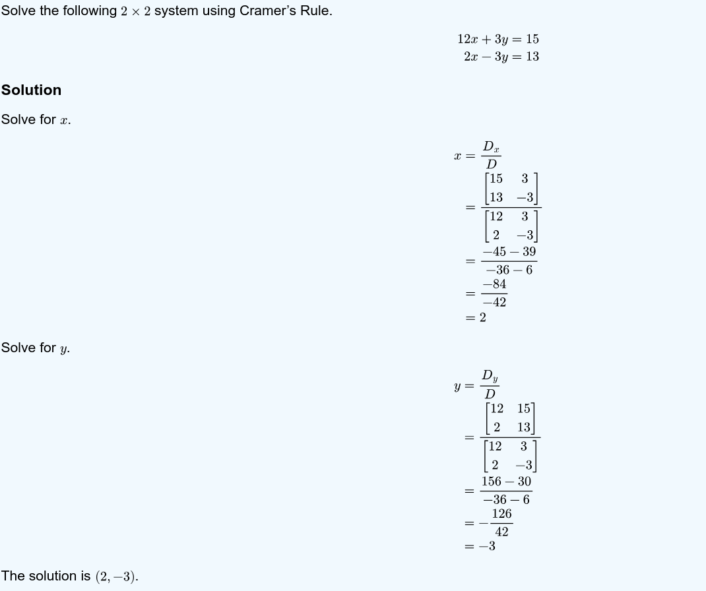

Slide 6
Applications of Cramer's Rule
- Used in solving small systems of linear equations
- Useful in theoretical mathematics and engineering
- Basis for understanding matrix-based solutions in linear algebra

